Slide 1

CSE357:
COMBINATORIAL STUDIES
Lecture #0
The kick start session

Slide 2
Course details
LTP – 2 0 2
Credit – 3

Slide 3
Assessment/Evaluation Scheme
Attendance: 5
CA: 25
MTT:20
ETT: 50

Slide 4
Complete evaluation criteria for the course
CA1: 30 marks- MCQ
CA2: 30 marks- SQL Query Writing
CA3: 30 marks- Interview

Slide 5
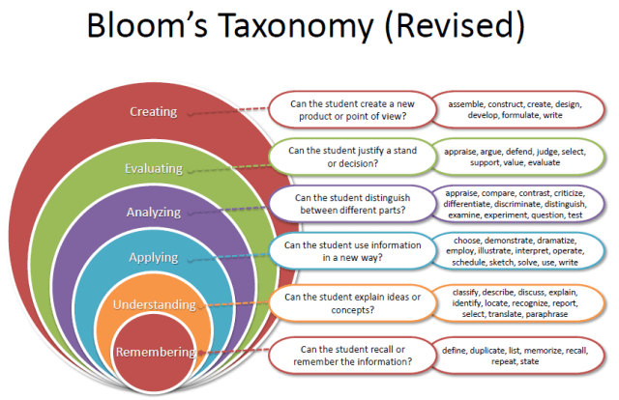
Revised Bloom’s Taxonomy

Slide 6
Course outcome
Course Outcomes :Through this course students should be able to
CO1: Attain proficiency in fundamental computer science concepts, including data structures, algorithms, databases, operating systems, and computer networks, essential for technical interviews.
CO2: Enhance problem-solving skills specific to coding challenges and algorithmic problems frequently encountered in technical interviews.
CO3: Cultivate a comprehensive command of Object-Oriented Programming principles, enhancing readiness to excel in technical interviews.
CO4: Acquire comprehensive strategies and techniques to effectively prepare for technical interviews, including mock interviews, resume building, and effective communication during interviews.
CO5: Acquire the requisite knowledge and skills to confidently address technical interview inquiries posed by service-oriented IT companies, demonstrating proficiency across diverse technical domains.
CO6: Engage in practice sessions including mock interviews, whiteboard coding exercises, and simulations of behavioural interview scenarios, fostering confidence and preparedness for different stages of technical interviews.

Slide 7
Program Outcomes
PO1 Engineering knowledge: Apply the knowledge of mathematics, science, engineering fundamentals, and an engineering specialization to the solution of complex engineering problems.
PO2 Problem analysis::Identify, formulate, research literature, and analyze complex engineering problems reaching substantiated conclusions using first principles of mathematics, natural sciences, and engineering sciences.
PO3 Design/development of solutions::Design solutions for complex engineering problems and design system components or processes that meet the specified needs with appropriate consideration for the public health and safety, and the cultural, societal, and environmental considerations.
PO4 Conduct investigations of complex problems::Use research-based knowledge and research methods including design of experiments, analysis and interpretation of data, and synthesis of the information to provide valid conclusions.

Slide 8
Program Outcomes
PO5 Modern tool usage::Create, select, and apply appropriate techniques, resources, and modern engineering and IT tools including prediction and modeling to complex engineering activities with an understanding of the limitations.
PO6 The engineer and society::Apply reasoning informed by the contextual knowledge to assess societal, health, safety, legal and cultural issues and the consequent responsibilities relevant to the professional engineering practice.
PO7 Environment and sustainability::Understand the impact of the professional engineering solutions in societal and environmental contexts, and demonstrate the knowledge of, and need for sustainable development.
PO8 Ethics::Apply ethical principles and commit to professional ethics and responsibilities and norms of the engineering practice.
PO9 Individual and team work::Function effectively as an individual, and as a member or leader in diverse teams, and in multidisciplinary settings.

Slide 9
Program Outcomes
PO10 Communication::Communicate effectively on complex engineering activities with the engineering community and with society at large, such as, being able to comprehend and write effective reports and design documentation, make effective presentations, and give and receive clear instructions.
PO11 Project management and finance::Demonstrate knowledge and understanding of the engineering, management principles and apply the same to one’s own work, as a member or a leader in a team, manage projects efficiently in respective disciplines and multidisciplinary environments after consideration of economic and financial factors.
PO12 Life-long learning::Recognize the need for, and have the preparation and ability to engage in independent and life-long learning in the broadest context of technological change.
PO13 Competitive Skills::Ability to compete in national and international technical events and building the competitive spirit alongwith having a good digital footprint.

Slide 10
Course contents
Unit I :Operating System Basics
Foundations of Operating Systems, Types of Operating Systems, Memory Management and Job Scheduling
Memory Management in Operating Systems, Job Scheduling and Process Loading, Processor Scheduling Algorithms, Process Synchronization and Interprocess Communication
Resource Management, Protection mechanisms

Slide 11
Course contents
Unit II: Computer Networking Basics
Foundations of Computer Networks, Elements and Types of Networks, Data and Signals
Network Topologies and Transmission Medium, Network Models and Protocols
Understanding OSI and TCP/IP Models, Working of TCP/IP Model (Internet), Key Protocols: HTTP, SMTP, FTP, DNS, DHCP, Overview of Traceroute and Ping

Slide 12
Course contents
Unit III: Database Management Systems (DBMS)
Introduction to Databases and RDBMS, Basics of Databases and RDBMS, Data Definitions: Tables, Fields, Records, SQL and Data Manipulation, Database Keys and Data Integrity
Database Normalization and Transactions, Fundamentals of Normalization, Transaction Management in DBMS

Slide 13
Course contents
Unit IV: Fundamentals of Programming Languages
C/C++/Java Interview Questions Overview, Variables, Data Types, and Memory, Pointers and Storage, Classes, Introduction to Object-Oriented Programming (OOP), Compiler and Interpreter Basics, Understanding Process Loading and Linking
Techniques of Parameter Passing and Binding, Storage Organization and Storage Classes, Advanced OOP Concepts and Data Structures
Abstract Data Types (ADTs), Data Structure Principles, Advanced Programming Techniques, Memory Handling in OOP Languages

Slide 14
Course contents
Unit V: Algorithms and Data Structures
Understanding Algorithms and Analysis, Running Time Analysis and Rate of Growth
Asymptotic Notation: Big-O Notation, Data Structures and Recursive Algorithms, Recursion and Backtracking
Linked Lists, Stacks, and Queues, Trees and Binary Search Trees (BSTs)

Slide 15
Course contents
Unit VI: Advanced Algorithms and Problem-Solving Techniques
Sorting and Searching Algorithms, Classification and Comparison of Sorting Algorithms, Linear and Non-Linear Searching Techniques
Hashing and Hash Table Implementation, Graph Algorithms and Design Strategies, Graph Representation and Traversals
Shortest Path Algorithms, Introduction to Greedy, Divide and Conquer, and Dynamic Programming Strategies

Slide 16
Text & Reference Books
Textbook
IT Interview Questions, Narasimha Karumanchi
Reference
CRACKING the CODING INTERVIEW, by Gayle Laakmann McDowell
Cracking the IT Interview, by M Balasubramaniam, K. R Baalaji, Kiran. G Ranganath, Nandawat Ravindra K, M Selvaguru, T Comerica Subash, Raghavan S Venkat, S Anbazhagan Vikram
SQL in 10 Minutes, Sams Teach Yourself, by Ben Forta
MCQs in Computer Science, by Timothy Williams

